Slide 1
Dog Behavioural Monitoring System
2020_045

Slide 2

Overall Project Description
Introduction
Developing a mobile application which tracks and monitors the behaviour of the pet dogs.
This application will track the unusual behavioural changes and notify the user.
Research Problem
Dogs may undergo different health conditions which are not noticed by their owners.
Differences in the behaviors such as resting, walking, barking behaviour of the pet dog based on breed and age should be noticed by the owners in order to identify their unusual behaviors.
Research Objectives
Main Objective
Tracking the behavioral changes of the dogs using image processing and machine learning concepts and notifying the pet owners via a mobile application is the main objective of this research.
Sub Objectives
Identify the dog breed using computer vision and specify the unique characteristics of the dog.
Analyze the walking behavior pattern of the dog based on breed and age using machine learning algorithms.
Analyze the resting behavior pattern of the dog based on breed and age using computer vision.
Analyze the unusual barking behavior patterns of the dog using computer vision and audio analysis.

Slide 3
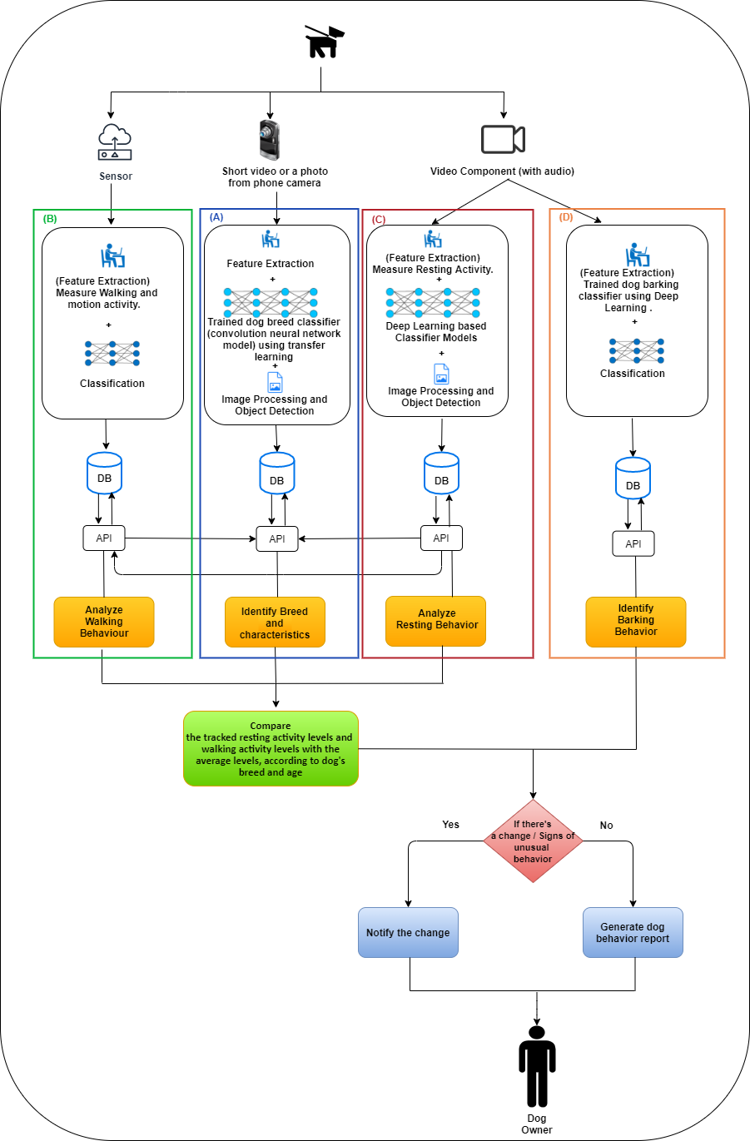
Overall solution as a system diagram

Slide 4

Dog Breed Identification
IT16175426
Herath HMKS
2020-045

Slide 5
Background / Research Gap
There are systems that can identify dogs’ breed using image processing but moving beyond that approach, currently there are no systems that have the ability to sort out the behavioral patterns such as resting and walking based on the identified breed of the dog.
IT16175426
Herath HMKS
2020-045

Slide 6
Research Question
Check whether our pet dog has the appropriate behavior according to its breed and to its age?
How to use dog breed identification to track unusual behaviors of a specific dog breed?
How image processing can be used to identify dog breeds?
IT16175426
Herath HMKS
2020-045

Slide 7
Research Question
Check whether our pet dog has the appropriate behavior according to its breed and to its age?
How to use dog breed identification to track unusual behaviors of a specific dog breed?
How image processing can be used to identify dog breeds?
IT16175426
2020-045
IT16175426
Herath HMKS

Slide 8
Objectives
Predict the pet dog breed in the video or photo using image processing.
Store resting hours and activity levels of different dog breeds according to their age.
Send resting hours and activity levels of the identified dog breed to the resting pattern recognition and the walking pattern recognition components as per their request to track unusual behaviors of the dog.
IT16175426
Herath HMKS
2020-045

Slide 9
Methodology
In order to identify the breed of the dog, the dog owner is asked to upload a photo or a small video of the dog via the mobile application. For identification of the dog breed, uploaded photo or small video is processed through the Inception V3 model which is trained to identify dog breed using transfer learning.
The dog breed which is identified using the photo or small video uploaded by the application user and the basic information regarding the dog like birthday, name, gender which are also input by the user through the application will be stored in the database. The resting time periods and the activity levels according to the two breeds (Pomeranian and German Shepherd) analysed in this proposed system and the age calculated according to the user input birthday will be stored.
IT16175426
Herath HMKS
2020-045

Slide 10
Methodology
An API is developed using flask framework to handle the communication among the dog breed identification model, database and other two components: resting pattern recognition and walking pattern recognition which requires data regarding resting time and the activity levels of the dogs.
The data regarding the activity and the resting time periods will be provided to the resting and walking pattern components as per their requests through the developed API.
IT16175426
Herath HMKS
2020-045

Slide 11
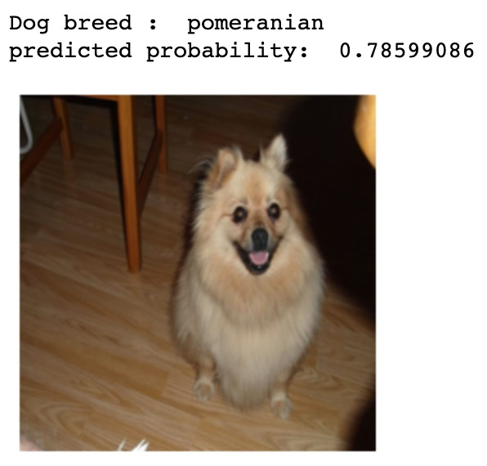
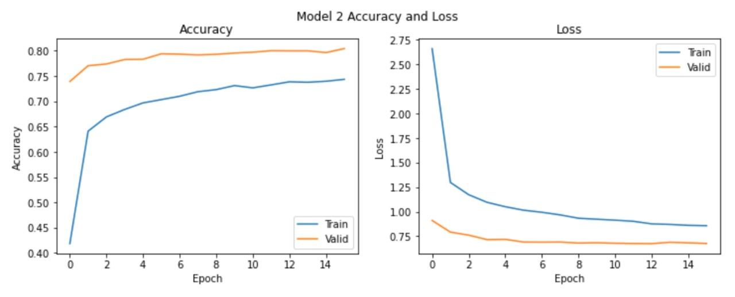
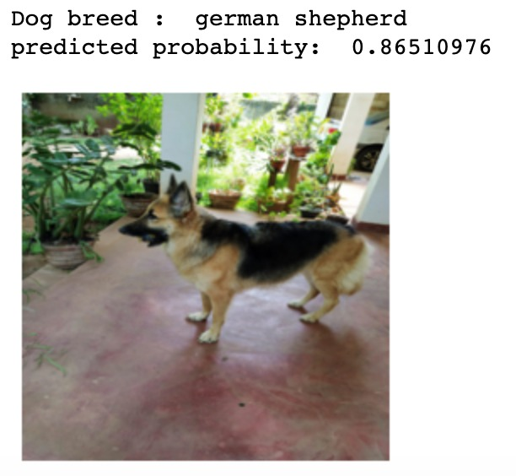
Achievements
Inception V3 model accuracy - 89%+
IT16175426
Herath HMKS
2020-045

Slide 12
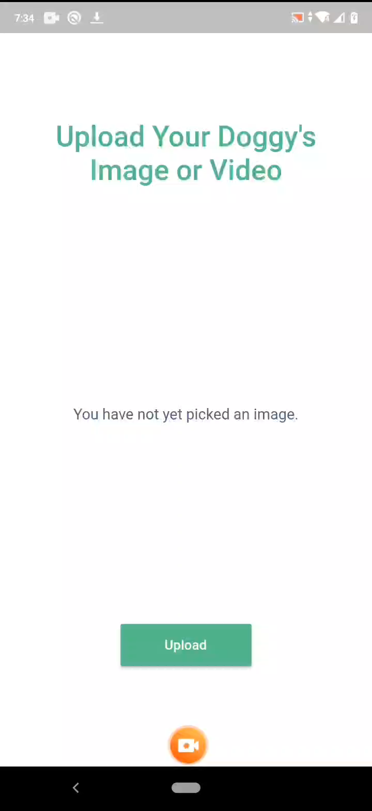
Achievements
IT16175426
Herath HMKS
2020-045

Slide 13

Walking Pattern Recognition
IT17133678
Boteju W.J.M
2020_045

Slide 14
Background / Research Gap
There are systems that can identify dogs’ breed using image processing but moving beyond that approach, currently there are no systems that have the ability to sort out the Walking Behavioral patterns based on the identified breed of the dog.
IT17133678
Boteju W.J.M
2020_045

Slide 15
Research Question
● How IMU sensors can be used to track dogs’ behavioral changes?
● Dog Activity Recognition (Walk, Run) since there may be confusion between distinguishing running activity from walking activity.
● Analyze whether the pet dog has the appropriate behavior according to its breed and to its age?
● How to track the changes in walking and motion activity levels using an IMU sensor?
IT17133678
Boteju W.J.M
2020_045

Slide 16
Objectives
Main objective
The main objective of the proposed research component is to build up a system that can track and monitor the walking activity levels of dogs according to their breed and age.
IT17133678
Boteju W.J.M
2020_045

Slide 17
Objectives
Sub Objectives
● Sub-Objective 1: Dog Activity Recognition (Walk, Run).
● Sub-Objective 2: Measure walking activity of the dog using an attached IMU Sensor device.
● Sub-Objective 3: Calculate average walking activity of the dog during normal health conditions.
● Sub-Objective 4: Compare walking and motion activity with average walking activity according to the breed and age and analyze the results.
● Sub-Objective 5: Notify if there is a change in walking and motion activity levels.
IT17133678
Boteju W.J.M
2020_045

Slide 18
Methodology
In order to measure the walking and motion patterns of the dog, an IMU sensor (6DOF MPU6050) which consists of a triaxial accelerometer and a triaxial gyroscope is attached to the collar of the dog.
The raw data obtained from the IMU sensor is obtained using a NodeMCU Wi-Fi development board with the help of the Arduino IDE. Once the raw data is obtained, the data will be run through an activity classifier with the help of a standard machine learning algorithm.
IT17133678
Boteju W.J.M
2020_045

Slide 19
Methodology
Dog activity recognition takes place accordingly (Walk, Run). The statistics will be updated and will be uploaded to a server. The amount of activity of the dog during motion activity is measured accordingly.
Average activity levels of the dogs based on its breed and age is already in the system. Based on the breed and age, we can identify if a dog is very active or not. The progressed results will be computed based on breed and age.
Updates are pushed to mobile application via cellular or Wi-Fi Connection. The health level of the dog is determined, and the user is notified if there is a change in activity levels.
IT17133678
Boteju W.J.M
2020_045

Slide 20
Methodology
Technological Approach
Models | Support Vector Machine
Programming languages | Python, C++, Dart
Libraries | Keras, SciKit learn, Arduino
Application Programming Interface (API) | Django REST framework, Arduino Server
Database | MongoDB
Version Controlling | GitHub
IT17133678
Boteju W.J.M
2020_045

Slide 21
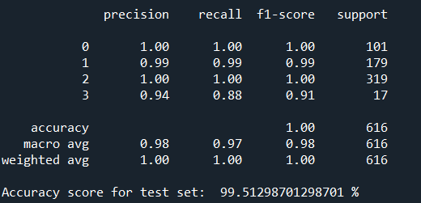
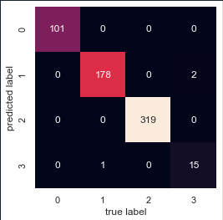
Achievements
Support Vector Machine was used on the test data and an accuracy score of 99.5% accuracy was obtained .
IT17133678
Boteju W.J.M
2020_045

Slide 22

Achievements
IT17133678
Boteju W.J.M
2020_045

Slide 23

Resting Pattern Recognition
IT17123150
M. D. P. Peiris
2020_045

Slide 24
Background / Research Gap
Most of the dog activity trackers use only sensor device to track resting behavior of the dogs.
So far, it is rare to find a product that uses both sensor data and CCTV camera video feed data to track the resting behavior of the dog.
IT17123150
M. D. P. Peiris
2020_045

Slide 25
Research Question
How to identify behavioral changes in dog’s resting activity based on their breed and age, using both surveillance camera video feed and sensor data?
IT17123150
M. D. P. Peiris
2020_045

Slide 26
Objectives
Ability to identify whether the dog is in resting state, using image processing.
Ability to calculate the mean value of resting time using video feed data and sensor data.
Ability to compare the calculated mean resting activity level with the average resting activity level based on dog’s breed and age.
Ability to notify dog owner, if there are changes in resting activity level.
IT17123150
M. D. P. Peiris
2020_045

Slide 27
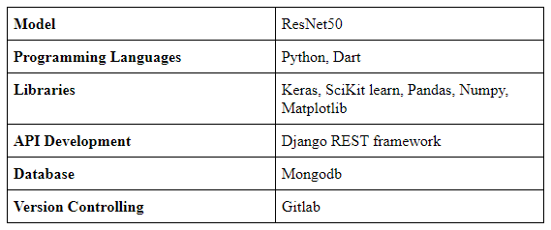
Methodology
IT17123150
M. D. P. Peiris
2020_045

Slide 28
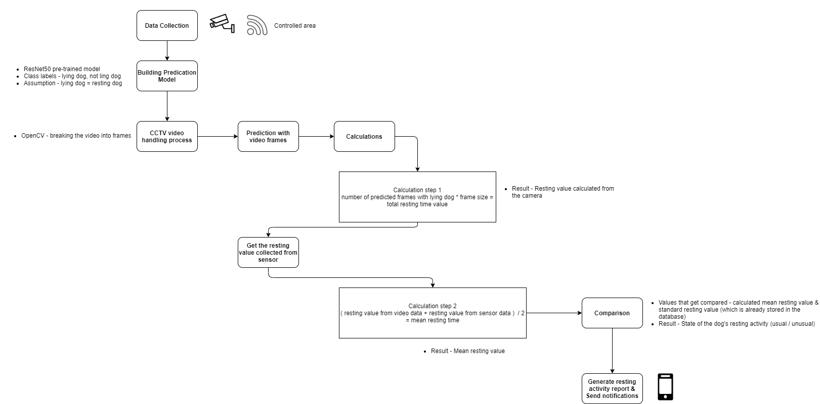
Methodology
IT17123150
M. D. P. Peiris
2020_045

Slide 29
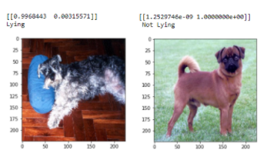
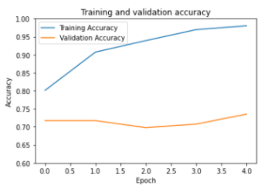
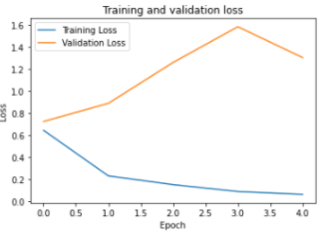
Achievement
Resting activity was predicted with 97% accuracy score.
IT17123150
M. D. P. Peiris
2020_045

Slide 30
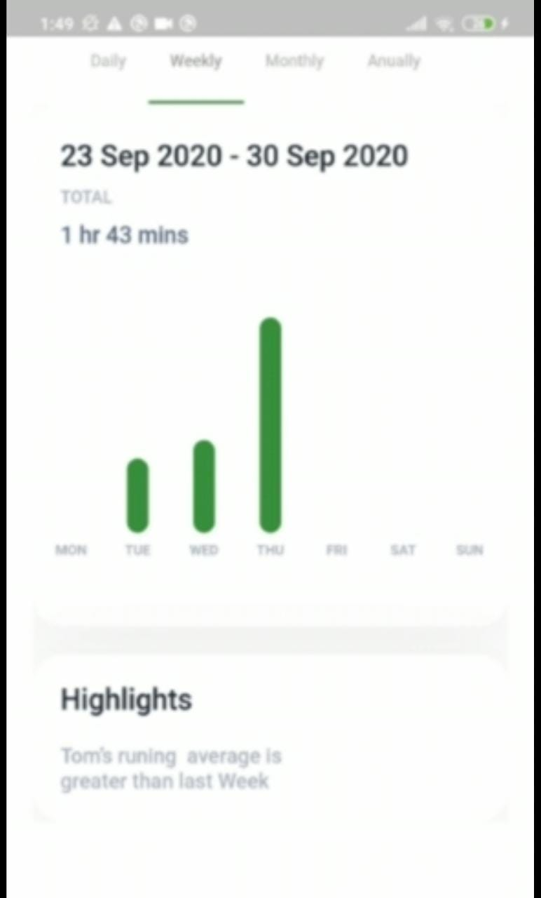
Achievement

Slide 31

Barking Pattern Recognition
IT17141352
A.K.P. Erandi Wathsala
2020-045

Slide 32
Background / Research Gap
There are current systems and products to control barking.
But no system to identify different barking patterns.
No system that notifies the user with identified barking patterns and unusual barking patterns.
CCTV camera is only being used for security purposes.
A.K. P. Erandi Wathsala
2020-045
IT17141352
2020-045

Slide 33
Research Question
How to track and monitor different barking patterns in order to identify the reason that caused using a surveillance camera.
IT17141352
A.K. P. Erandi Wathsala

Slide 34
Objectives
Ability to monitor different barking patterns using a surveillance camera.
Ability to identify different barking patterns using audio processing.
Ability to identify unusual barking patterns .
Notify user
IT17141352
A.K. P. Erandi Wathsala
2020-045

Slide 35
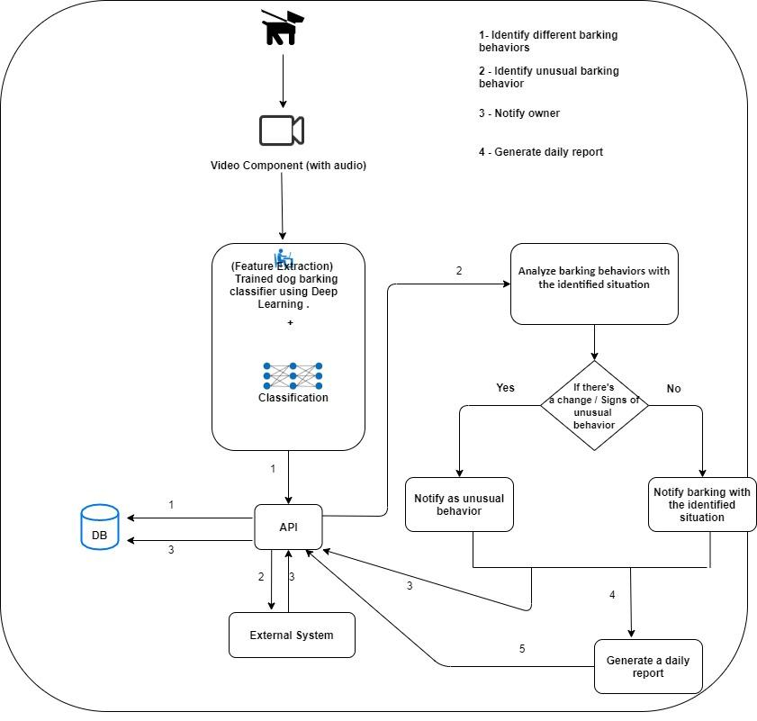
Methodology
IT17141352
A.K. P. Erandi Wathsala
2020-045

Slide 36
Methodology
Collection of data from a surveillance camera within a restricted area.
Data preprocessing and feature extraction.
Predict the extracted features using trained model.
Identify unusual behaviors apart from the usual barking behaviors.
Connetion of API & Sending notification via mobile application.
IT17141352
A.K. P. Erandi Wathsala
2020-045

Slide 37
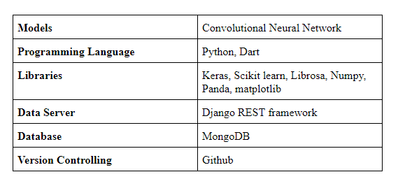
Methodology
A.K . P. Erandi Wathsala
IT17141352
2020-045

Slide 38
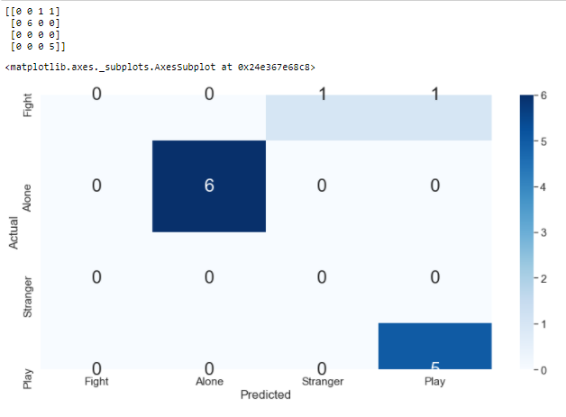
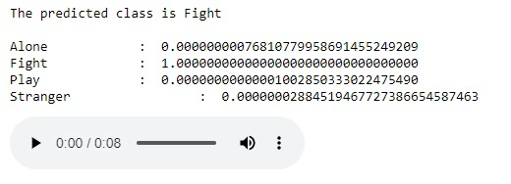
Achievement
Predicted Outcome from the CNN model
IT17141352
A.K. P. Erandi Wathsala
2020-045

Slide 39
Achievement

Slide 40
REFERENCES
[1] Csaba Molnár, Frédéric Kaplan, Pierre Roy, François Pachet, Péter Pongrácz, Antal Dóka, Ádám Miklósi; “ClassiWcation of dog barks: a machine learning approach”, Animal Cognition 11(3):389-400, August 2008. [online] Available at: https://www.researchgate.net/publication/5654967_Classification_of_dog_barks_A_machine_learning_approach
[2] Che Yong Yeo, S.A.R. Al-Haddad, Chee Kyun Ng, “Animal Voice Recognition for Identification (ID) Detection System. [online] Available at: https://www.researchgate.net/profile/Syed_Abdul_Rahman_Al-Haddad/publication/251999286_Animal_voice_recognition_for_identification_ID_detection_system/links/55470d210cf23ff71686f8a6/Animal-voice-recognition-for-identification-ID-detection-system
[3] Mikael Henaff, Kevin Jarrett, Koray Kavukcuoglu and Yann LeCun, “UNSUPERVISED LEARNING OF SPARSE FEATURES FOR SCALABLE AUDIO CLASSIFICATION”, 12th International Society for Music Information Retrieval Conference (ISMIR 2011). [online] Available at: https://archives.ismir.net/ismir2011/paper/000128.pdf

